Slide 1
Evaluation of Recommenders
Hunter
2023-06-25

Slide 2
How should we evaluate recommender system?
How should we run assessments?
Offline
User study
Online experiments
How well is it achieving our goal?
How does the recommender perform in terms of different properties?
Are they relevant for user experience?
Design algo to optimize the properties we care (usually with trade-off?)
Reference: https://www.bgu.ac.il/~shanigu/Publications/EvaluationMetrics.17.pdf
Notes:
Often it is easiest to perform offline experiments using existing data sets and a protocol that models user behavior to estimate recommender performance measures such as prediction accuracy.
A more expensive option is a user study, where a small set of users is asked to perform a set of tasks using the system, typically answering questions afterwards about their experience.
Finally, we can run large scale experiments on a deployed system, which we call online experiments. Such experiments evaluate the performance of the recommenders on real users which are oblivious to the conducted experiment.

Slide 3
Offline experiments
An offline experiment is performed by using a pre-collected data set of users choosing or rating items. Using this data set we can try to simulate the behavior of users that interact with a recommendation system.
Pros | Cheap and easy to run, can compare multiple algos easily
Cons | Can only answer limited questions (usually about prediction accuracy) No measure of user interaction
Best For | Screening of algos / parameter tuning

Slide 4
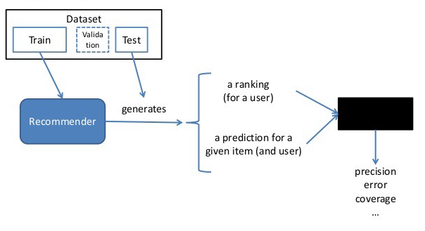
Typical offline evaluation design
Key factors for protocol choice:
Sequential impact
Absolute
Relative
No timestamp, etc.
Given N rated and hidden items
https://medium.com/fnplus/evaluating-recommender-systems-with-python-code-ae0c370c90be

Slide 5
User study
A user study is conducted by recruiting a set of test subject, and asking them to perform several tasks requiring an interaction with the recommendation system. While the subjects perform the tasks, we observe and record their behavior, collecting any number of qualitative and quantitative measurements
Pros | Answers widest set of questions, esp. user interactions Collects qualitative data to help interpret quantitative data
Cons | Expensive -> small sample size Representativeness: sample size / paid study / subject know they are being observed
Best For | Pilot study to find bugs and improve recommender Getting read on recommender’s effect on user interaction
Notes:
In many cases we can ask qualitative questions, before, during, and after the task is completed. Such questions can collect data that is not directly observable, such as whether the subject enjoyed the user interface, or whether the user perceived the task as easy to complete.
It’s best that the users do not know the purpose of study

Slide 6
Online experiment
Deploy one or more recommender algos and compare them live via A/B testing or multiple tests. Randomization is important for a fair comparison. This is usually done last to minimize user dissatisfaction as negative result will lead to bad customer experience and potential permanent damage
Pros | Provides the strongest evidence as to the true value of the system Allow direct measurement of overall system goals, such as long-term profit or user retention
Cons | Takes lots of time and effort to deploy Risk of bad customer experience
Best For | Optimizing algos that passed offline and user study, quantify actual impact of recommender system
Notes:
The real effect of the recommendation system depends on a variety of factors such as the user’s intent (e.g. how specific their information needs are, how much novelty vs. how much risk they are seeking), the user’s context (e.g. what items they are already familiar with, how much they trust the system) ??, and the interface through which the recommendations are presented.

Slide 7
Properties of recommender
User preference
Prediction accuracy
Coverage
Confidence
Trust
Novelty
Serendipity
Diversity
Utility
Risk
Robustness
Privacy
Adaptivity
Scalability

Slide 8
User preference
Heavy / light users?
Minor / strong preference?
Ask why - will this scale, can we further improve it?
Notes:
Can run user test to get user interaction

Slide 9
Prediction accuracy
Opinion of item (ratings): RMSE, MAE, etc.
Probability of usage (purchase): Precision@top N, area under PR or ROC curve, F-stat
Ranking of items: Normalized Distance-based Performance Measure (NDPM), Spearman’s ρ or Kendall’s τ, Normalized Cumulative Discounted Gain (NDCG)
Additional lectures to watch:
Stanford lecture Eval metrics: https://youtu.be/VZKMyTaLI00
Wayfair DS ranking offline evaluation: https://youtu.be/qG0wUgsEugw
Notes:
A basic assumption in a recommender system is that a system that provides more accurate predictions will be preferred by the user. Thus, many researchers set out to find algorithms that provide better predictions.
Other challenges: prediction context, sequence, etc.

Slide 10
Coverage
Item space coverage: catalogue coverage, sales diversity
User space coverage
Cold start
Threshold for coldness is usually subjective

Slide 11
Confidence
E.g. trust in collaborative filtering improves with amount of data
Same rating but different confidence interval → choose recommender with tighter C.I.

Slide 12
User trust
Examples:
Recommend items the user likes or is familiar with, even though there is no incremental value
Provide explanation for recommendation
Could be measured/proxied by:
user study
number of time followed recommendation
number of repeated visits

Slide 13
Novelty & Serendipity
Novel recommendations are recommendations for items that the user did not know about, or did not report in data
Serendipity is a measure of how surprising the successful recommendations are.
Build distance metrics, reward successful recommendation with long distance
Important to check effect over time
Notes:
One can think of serendipity as the amount of relevant information that is new to the user in a recommendation, or deviation from the “natural” prediction

Slide 14
Utility
E.g. e-commerce use recommendation to increase cross-sell
Utility and long term return >> recommendation accuracy

Slide 15
Final notes
Know your key metrics (focus on more than accuracy)
Know your limitations
Design and iterate fast

Slide 16
References (recommend to read and watch!)
Paper on recommender evaluation : https://www.bgu.ac.il/~shanigu/Publications/EvaluationMetrics.17.pdf
Stanford lecture Eval metrics: https://youtu.be/VZKMyTaLI00
Wayfair DS ranking offline evaluation: https://youtu.be/qG0wUgsEugw

